Slide 1

Task catalyst
Oral Presentation 2 – Software Demo
Notes:
NOTE: Want a different image on this slide? Select the picture and delete it. Now click the Pictures icon in the placeholder to insert your own image.

Slide 2

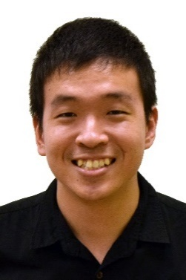
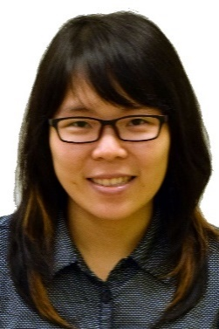

Introduction
Zhen Yu
Kelvin
Thida
Wei Jie
Introduction
Functionalities of the system
Software Demonstration
Software Demonstration

Slide 3
Target Audience

Slide 4
SOFTWARE FEATURES

Slide 5
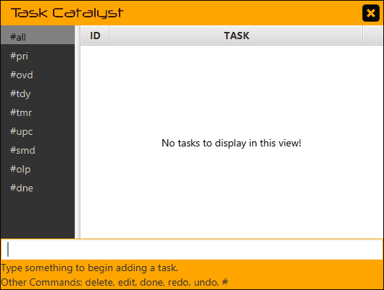

Software Features
Keep things in view.

Slide 6


Software Features
Never miss a deadline.

Slide 7
Software Features
Remember every single date.

Slide 8
Software Features
Know how long it takes.

Slide 9
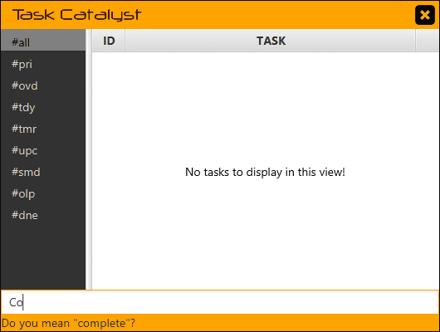
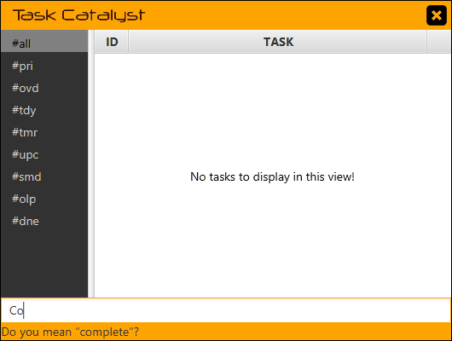
Software Features
Simplify the complex.

Slide 10
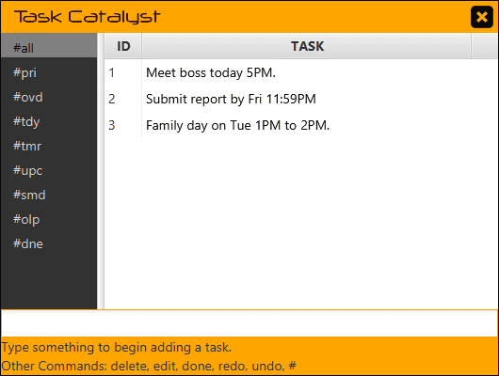
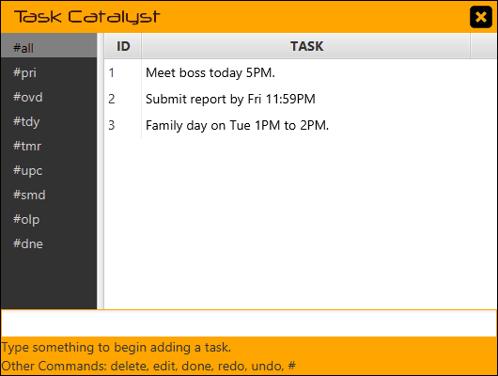
Software Features
Focus on the task.

Slide 11


Software Features
Find the right words.

Slide 12
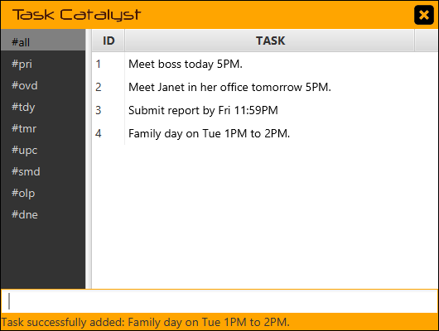
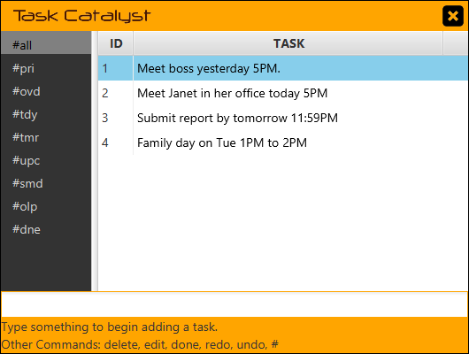
Software Features
Stay current.

Slide 13


Software Features
Get things done.

Slide 14
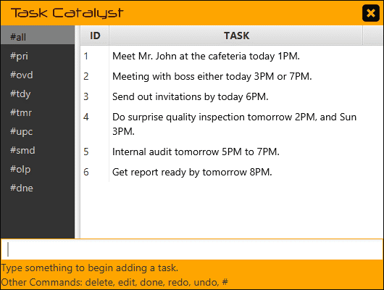

Software Features
One thing at a time.

Slide 15


Software Features
Make smart decisions.

Slide 16
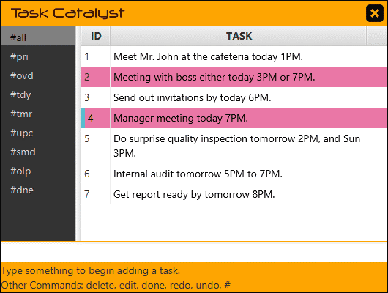
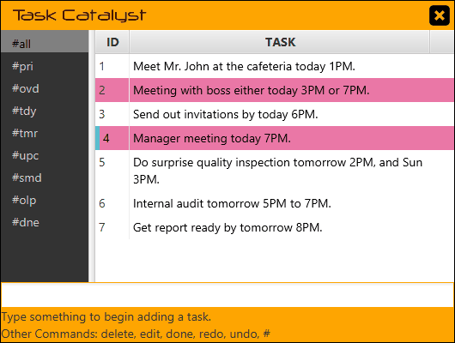
Software Features
Refine your plans.

Slide 17


Software Features
Keep only what you need.

Slide 18
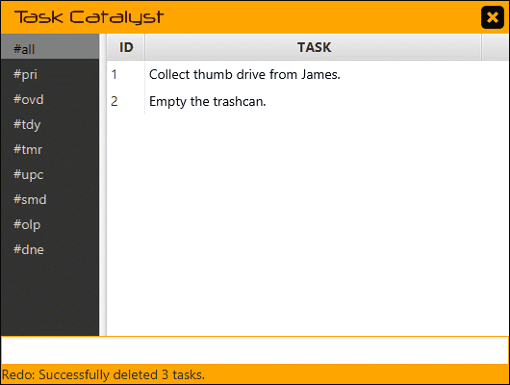
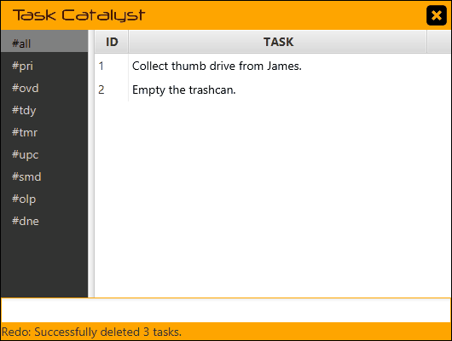
Software Features
Turn back time.
CTRL + Z: Undo
CTRL + Y: Redo

Slide 19
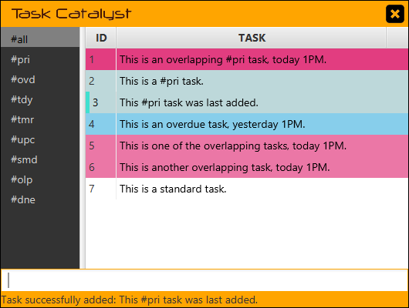
Software Features
Priority Tasks
Timed Tasks
Focus on the important.
Other Tasks

Slide 20
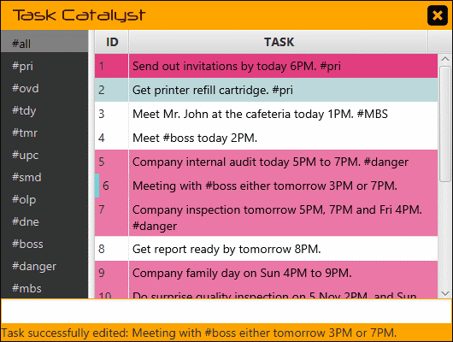

Software Features
Find what you need.

Slide 21
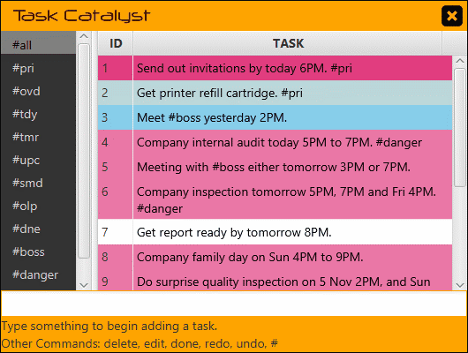

Software Features
All
Priority
Overdue
Today
Tomorrow
Upcoming
Keep organized.
Someday
Overlapping
Done

Slide 22
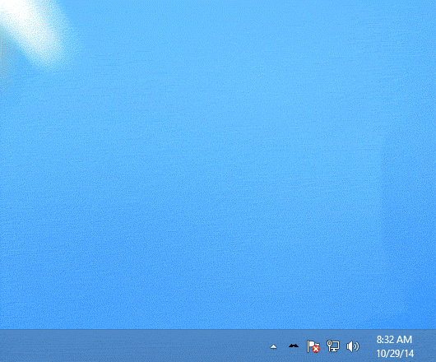

Software Features
Always ready for you.
CTRL + M : Minimize/Maximize
CTRL + E : Exit

Slide 23
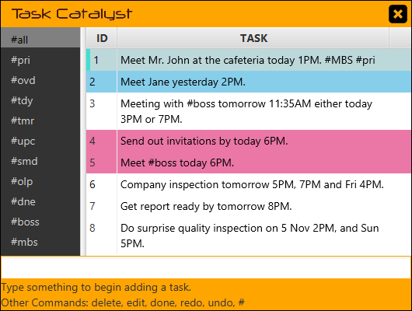
Software Features
Keep things in view.
Never miss a deadline.
Remember every single date.
Know how long it takes.
Simplify the complex.
Focus on the task.
Find the right words.
Stay current.
Get things done.
One thing at a time.
Make smart decisions.
Refine your plans.
Keep only what you need.
Turn back time.
Focus on the important.
Find what you need.
Keep organized.
Always ready for you.

Slide 24
SOFTWARE DEMONSTRATION

